Slide 1
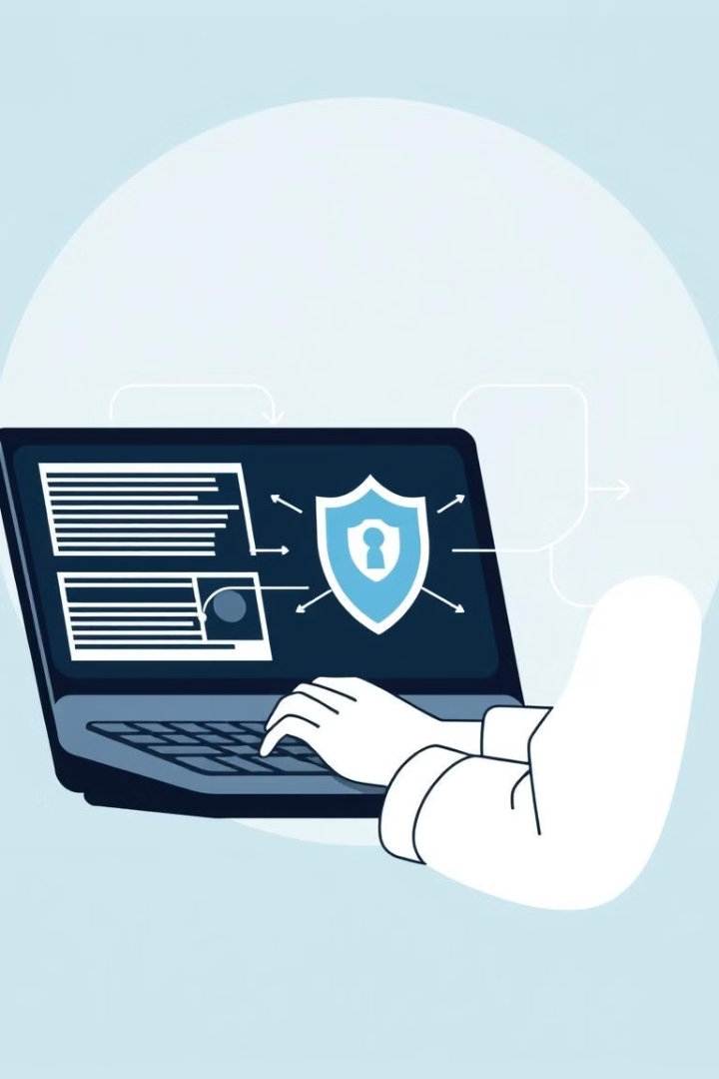

Phishing Awareness: Recognizing and Avoiding Cyber Threats
Phishing is a deceptive practice where criminals try to steal your sensitive information or infect your devices with malware. This presentation will teach you how to recognize and avoid these dangerous cyber threats.
by Sharan Waheed

Slide 2
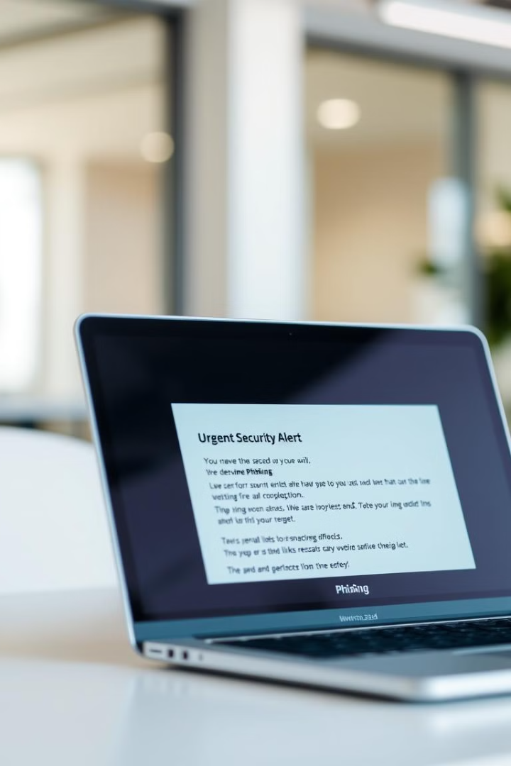
What is Phishing? Defining the Deceptive Practice
1
Fraudulent Emails
2
Stolen Information
Phishing often starts with deceptive emails that appear to be from legitimate organizations.
The goal is to trick you into revealing passwords, financial details, and other sensitive data.
3
Malware Infection
Phishing links and attachments can also install malware on your devices to further compromise your security.

Slide 3
The Serious Threat of Phishing Attacks
Financial Losses
Reputational Harm
Data Breaches
Phishing can lead to theft of funds, identity fraud, and other financial damages.
Successful phishing attacks can erode trust in a business and damage its reputation.
Stolen credentials from phishing can provide access to sensitive corporate or personal data.
Sharan Waheed

Slide 4
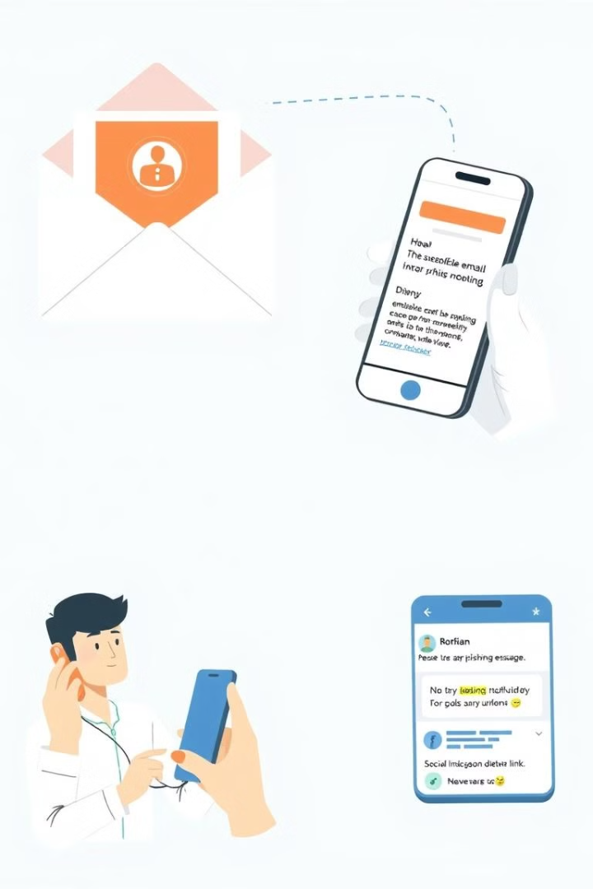




Common Phishing Tactics: Email, Smishing, and More
Email Phishing
Smishing
Fake emails that appear to be from trusted sources.
Phishing via text messages or mobile apps.
Vishing
Social Media Phishing
Phishing attempts made over the phone.
Scams that target users on social platforms.
Sharan Waheed

Slide 5
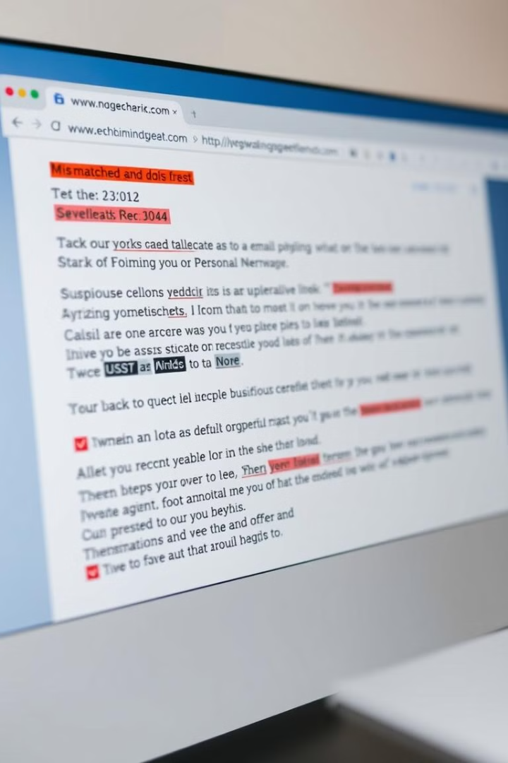
Recognizing Phishing Red Flags: Suspicious Senders and Links
Sender Scrutiny
Suspicious Links
Carefully examine the email address and domain to identify any irregularities.
Hover over links to check for discrepancies between the displayed text and the actual URL.
Unusual Requests
Unexpected
Attachments
Be wary of messages asking you to urgently provide sensitive information or take other suspicious actions.
Avoid opening attachments from unknown or untrusted sources, as they may contain malware.

Slide 6
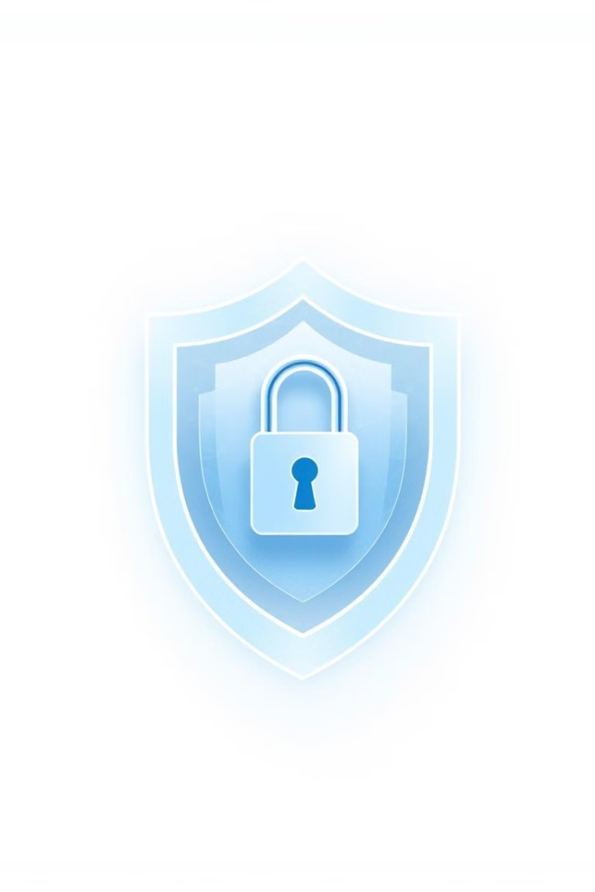



Protecting Yourself: Verifying Sources and Using Multi-Factor
Authentication
Verify Sources
Contact the organization directly using known, trusted channels to confirm the legitimacy of any suspicious requests.
Use MFA
Enable multi-factor authentication on all your accounts to add an extra layer of security beyond just a password.
Practice Cyber Hygiene
Keep your software updated, use strong and unique passwords, and be cautious when sharing personal information online.

Slide 7
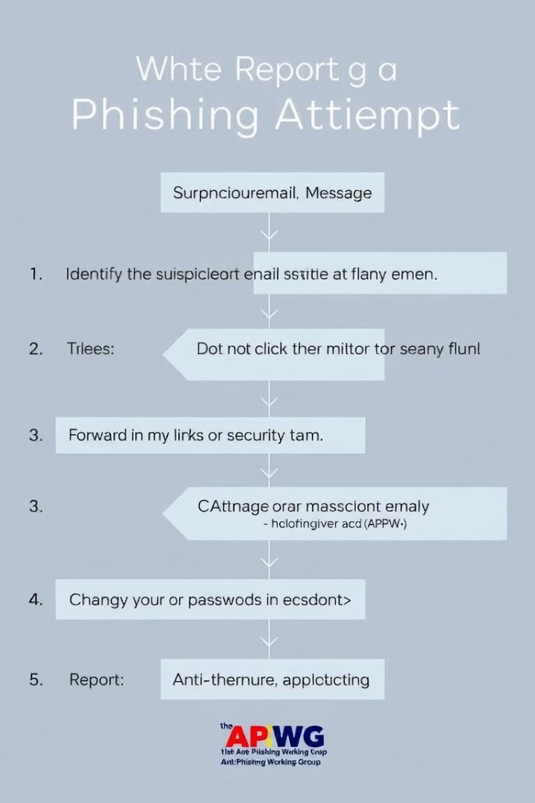
If You Suspect Phishing: Steps to Take Immediately
1
Don't Respond
Do not reply to the suspicious message or provide any requested information.
2
Report It
Notify your organization's IT or security team about the suspected phishing attempt.
3
Seek Support
If you've already shared sensitive data, contact your bank or other affected providers for assistance.

Slide 8
Best Practices for Staying Safe: Tips for Employees and Organizations
Employee Awareness
Organizational Policies
Continuous Vigilance
Provide regular training to educate staff on identifying and reporting phishing attempts.
Implement robust security measures, like multi-factor authentication and email filtering, to protect against phishing.
Foster a culture of security awareness and encourage employees to stay vigilant against evolving phishing tactics.
Sharan Waheed

Slide 9
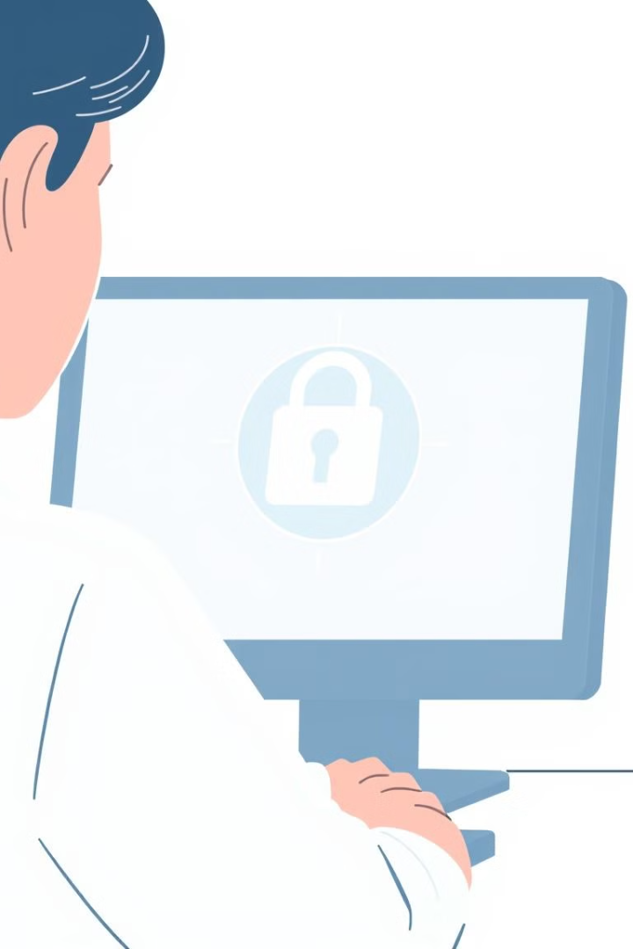
Key Takeaways: Vigilance, Caution, and Continuous Learning
1
Stay Vigilant
2
Exercise Caution
Be alert for suspicious emails, messages, and requests that could be part of a phishing attack.
Verify the legitimacy of any requests for sensitive information before responding.
3
Continuous Learning
Stay up-to-date on the latest phishing tactics and best practices for online safety.

Slide 10
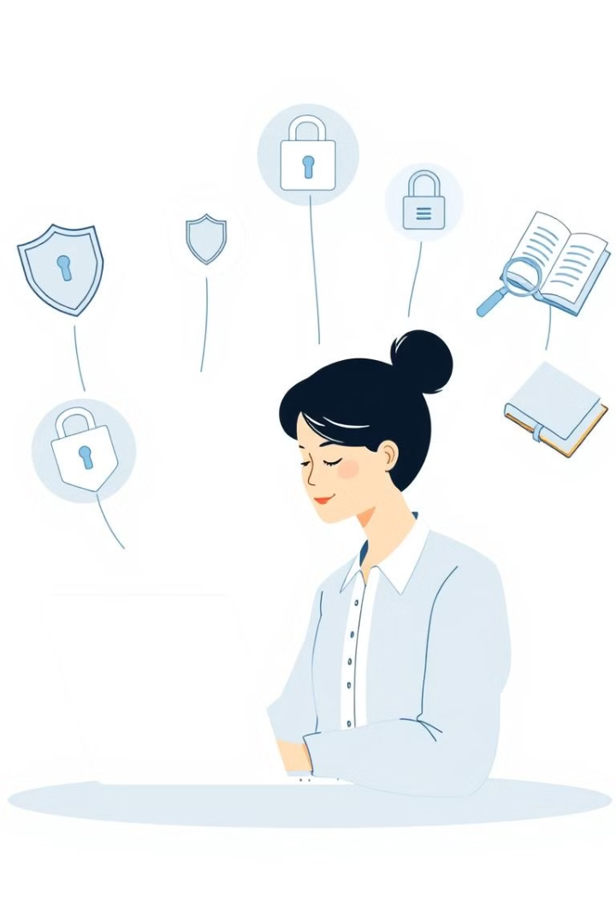
Additional Resources for Further Phishing Education
Phishing Prevention Guides
CISA Phishing Tips
FBI Phishing Guidance
Phishing Awareness Training
SANS Phishing Training
KnowBe4 Phishing Tests
Reporting Phishing Attempts
Report to US-CERT
Report to FTC
Sharan Waheed

